Slide 1

DH2015:
Publish: whatever the price
A cost structure study for french journals
publishing in social sciences and humanities
Scientific digital Library (BSN) is a groupe of actors and organisms for dissemination of research formed by the french ministry of research. BSN7 is a piece of that larger group and is dedicated to public scientific publishing. This group decided on a survey and came out with some findings that we are presenting here today.
An article is to be published soon and has been writen by two members of that group, Odile Contat and Anne-Solweig Gremillet.
I am today, as a publisher working with BSN7, the voice of both the group and the writers.

Slide 2
The study context
The publication of articles in scientific journals is a major challenge for french research’s institutions because:
it is an essential vehicle for the visibility of researchers work
it is essential to maximize the impact of research
This type of publication has a cost for public institutions such as:
financing the editorial and production processes
Financing licences for the use of those contents through libraries
Ensure the access to the community (researchers, students, public,…)
The issue of Open Access to scientific publications financed by public funds is pregnant:
Since 1984, as an assignment, universities are to disseminate knowledge and research results
In 2012, the European Commission issued a recommendation encouraging Member States to OA broadcasting for whatever scientific productions they finance
The new Code of Research recommends focusing on broadcasting such as open access modes (2013)

Slide 3
The survey’s methodology
March 2014 to January 2015
Objective1: to collect some recent and representative information on the diversity of situations, about the publishing costs of research journals in all disciplines, for a complete inventory and updates
Objective2: identify common parameters for various journals within their processes and their editorial financing, and produce recommendations to follow and accompany journals towards OA.
About the Survey scope, let us say: we looked into the costs of editorial contents and their production once the article is accepted after being peer reviewed. There was no measurement of research labor costs, and writing.
Peer review appeared to be a difficult “moment” item. Its measurement is moving back and forth from research to editing (through the fact that scientific expertise is peer reviewing but it is orchestrated by the editor in charge)
Step one: we conducted half a dozen interviews with journals or editors to describe in detail the working of their journals in order for us to sequence the various stages of the editorial production chain
Step 2: we conducted long qualitative interviews with 18 scientific journals to gather scientific and financial information on the time and costs required for each task in this chain
Step 3: we launched the quantitative survey as a questionnaire sent to 300 editors of scientific journals (issued by university presses, research centers, ...) between July 2014 and January 2015. The questionnaire included 66 items.

Slide 4
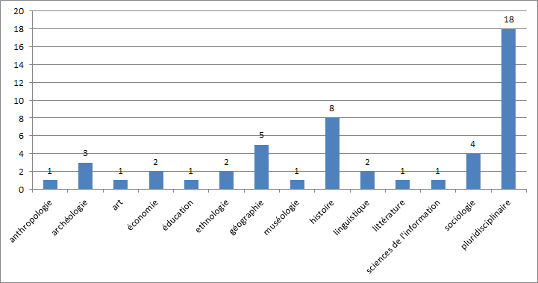
The final operated sample
Out of 62 collected responses, we withdrew 2 incomplete, and 9 STM
The final sample is 50 SSH journals with exploitable answers with disciplinary profiles such as:
anthropology, archeology, art, economy, education, ethnology, geography, museology, history, language, literature, information and documentation sciences, sociology, multidisciplinary.

Slide 5
Findings
The editorial contents in SSH are produced by public funds
The main editorial cost is the salary of the copy editor.
Commercial publisher when appears is primarily operating as a printer, and/or a distributor
The most important part of the publishing cost of an article is the salary of the copy editor:
The average time required for copy editing tasks per journal and per year is 10.5 months as for the 50 journals of our sample. The editor’s tasks we are talking about are: managing articles from their selection to their expertise (through peer review), rewrite some of the work, check critical apparatus and add missing references, copy edit, structure files through single source publishing process (with TEI-XML tools for example) and prepare paper and/or digital formats.
10.5 months makes an average of 42.000€ a year (salary).
We can conclude that the median cost for 1 item (article) produced in SSH is 1.330€ (minimum cost is 500 and maximum 4.000), and the median cost for 1 page is 66€ (minimum cost is 5 and maximum 200).
The share of the cost for the print, broadcast and distribution is not predominant in relation to the salary of the editor:
The response we got from 25 of the journals is that the yearly average cost for printing and distribution is 11.200€

Slide 6
Dissemination of SSH journals: OA and new questions
The journals in SSH in France are not applying the Article Processing Charge for support of the Open Access model (also called gold with APC) nor they are choosing a fully paid distribution model. Preferred modes of distribution are:
25 journals (50% of the sample) are distributed under subscription with a moving wall going from 1 to 5 years before going open access
20 journals (42%) chose a digital broadcast with OA mode: 9 exclusive OA and 11 with the freemium model (free access to html text and sale of related services and format)
5 journals (8%) do not have a digital access
Let us mention a few others findings:
historical disciplines mainly choose a moving wall with subscription
OA is heavily selected for geography, sociology and multidisciplinary journals
during qualitative interviews, the reasons for choosing OA, that geographers highlighted, are clearly the possibilities offered by the digital humanities
the cost of printing and distribution does not prevent the paper copy in addition to the digital version
the interviews revealed the symbolic strength of a paper version which is seen as providing legitimacy while ensuring supposed quality content.

Slide 7
Work to come for BSN7
First steps of the survey was to figure out the landscape, actors, functions, processes,... we did
2nd step is aiming to mesure the specificities of digital publishing (within and/or without the paper model process)
3rd step could be to measure impact of digital humanities in producing research and its dissemination

Slide 8
Remerciements
Thank you to DH2015 for selecting our paper
Thank you for listening to us
Thank you to Anne-Solweig and Odile who wrote the article
Thank you to BSN7 for that great work we did, do and will go on doing
Thank you to french ministry of research who made possible our visit here
Some links
BSN7 http://www.bibliothequescientifiquenumerique.fr/?-Edition-scientifique-
The survey http://www.bibliothequescientifiquenumerique.fr/?Enquete-sur-les-couts-editoriaux,62
Emails
Odile Contat CNRS Odile.CONTAT@cnrs-dir.fr
Anne-Solweig Gremillet INSEP anne-solweig.gremillet@insep.fr
Emmanuelle Corne éditions de la MSH ecorne@msh-paris.fr

